Slide 1
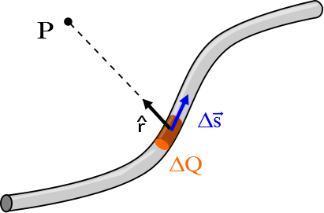

Slide 2
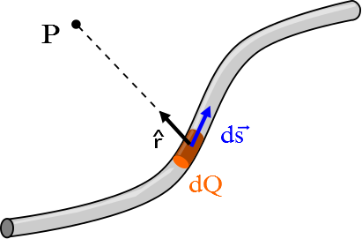

Slide 3
Current Loop
I
P
2a
2a

Slide 4
Current Loop
I
P
2a
^
θ
r
dx
x

Slide 5
Current Loop
I
P
2a
^
θ
r
dx

Slide 6
x
I
ds
φ
R
P
dB
y

Slide 7
x
ds
ϕ
I
ds
ϕ
R
x
θ
dB
θ
90°-θ
P
90°-θ
y
dB_{z}
y

Slide 8
x
dB
ds
ds
θ
x
R
θ
dB
90°-θ
θ
P
90°-θ
dB_{z}
I

Slide 9
http://ocw.mit.edu/ans7870/8/8.02T/f04/visualizations/magnetostatics/08-RingMagInt/08-ringMagInt320.html

Slide 10
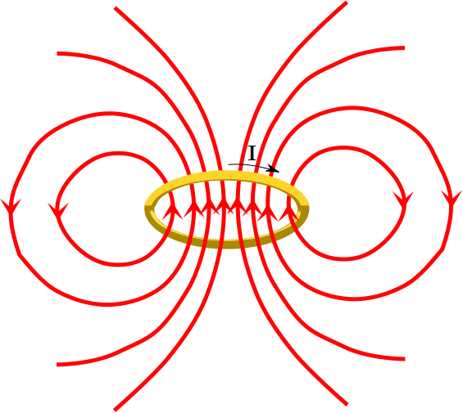

Slide 11
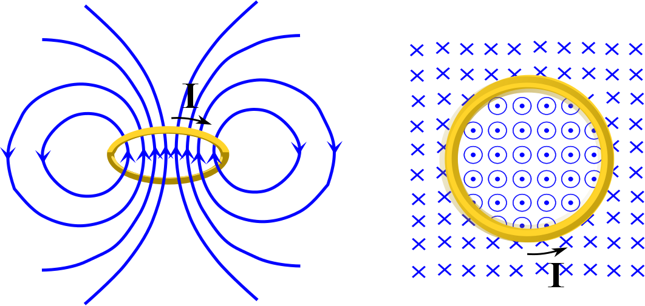

Slide 12
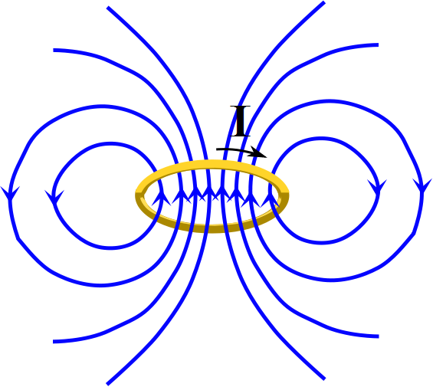

Slide 13
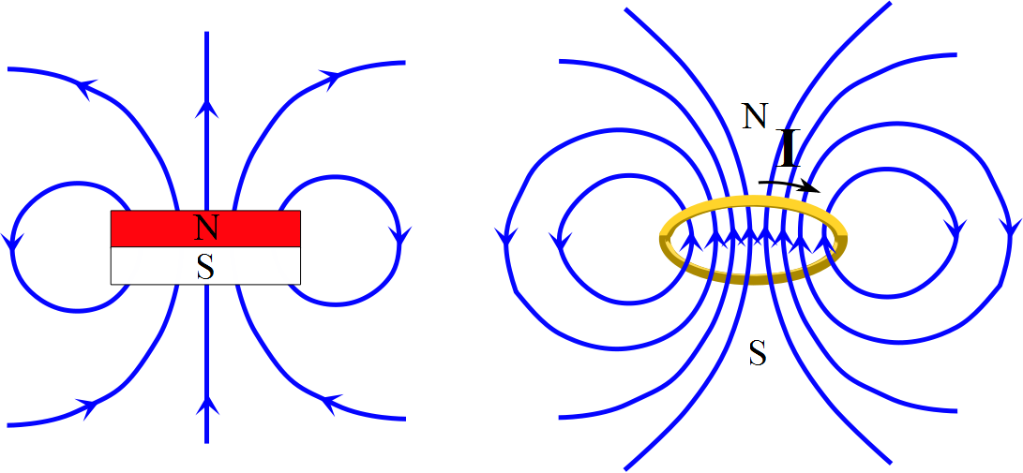

Slide 14
x
I
μ
R
z
y

